Slide 1
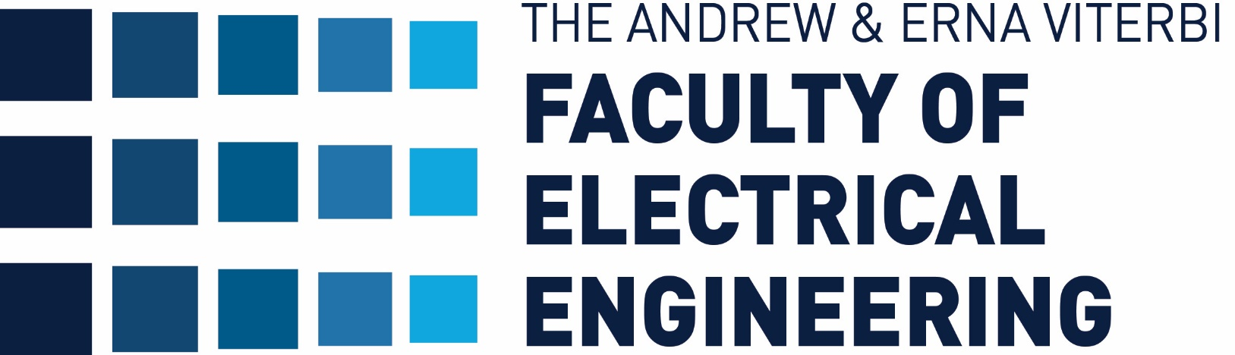


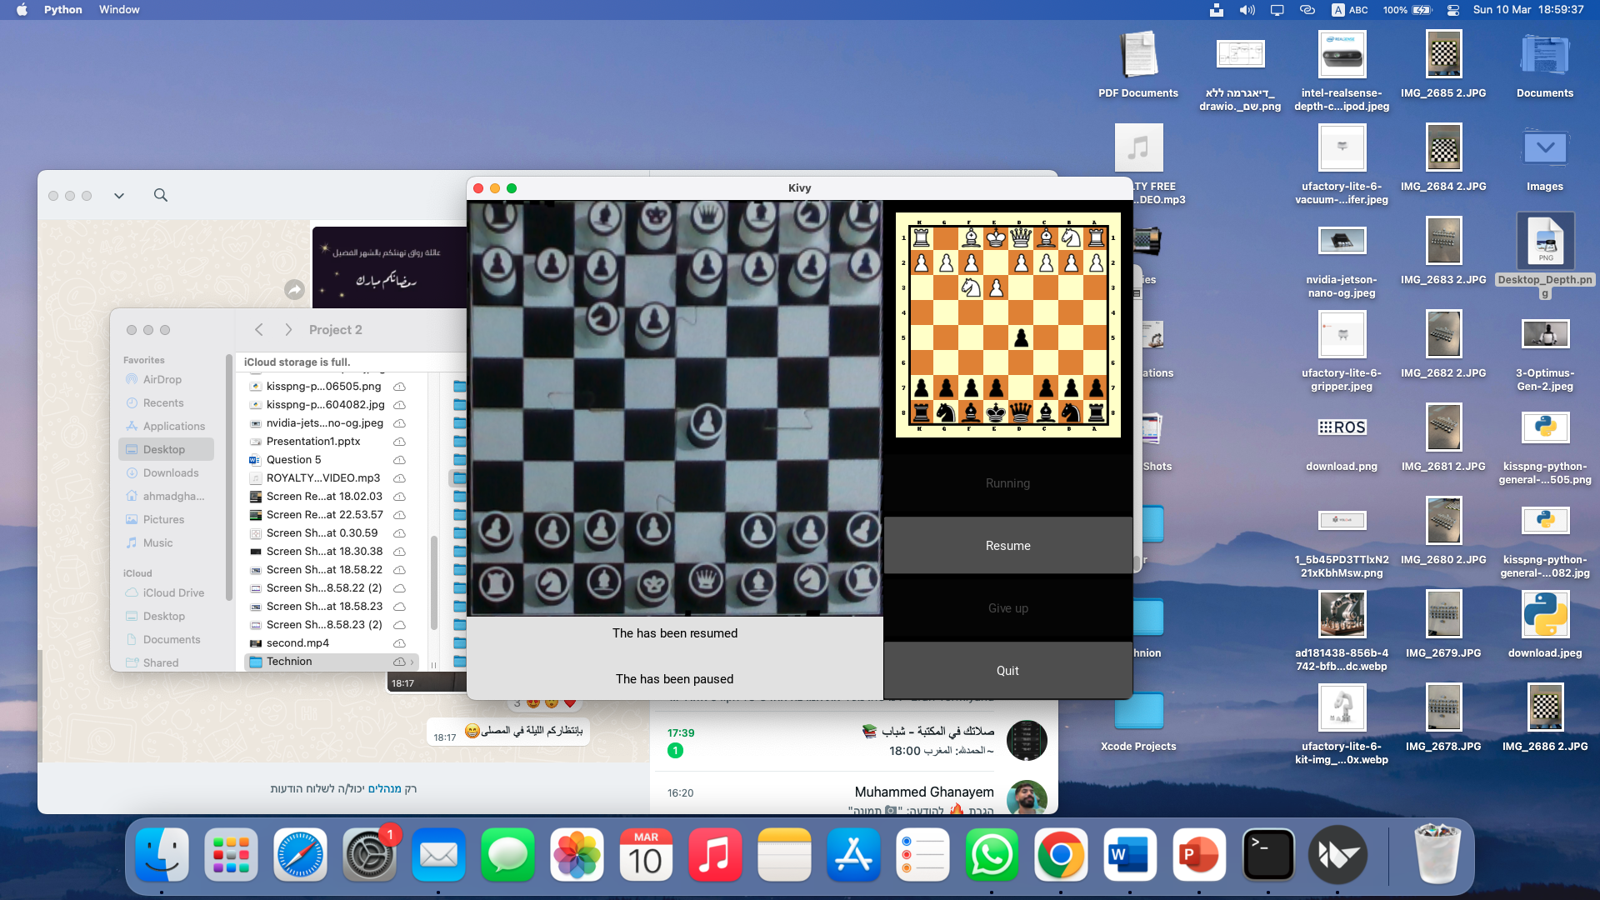
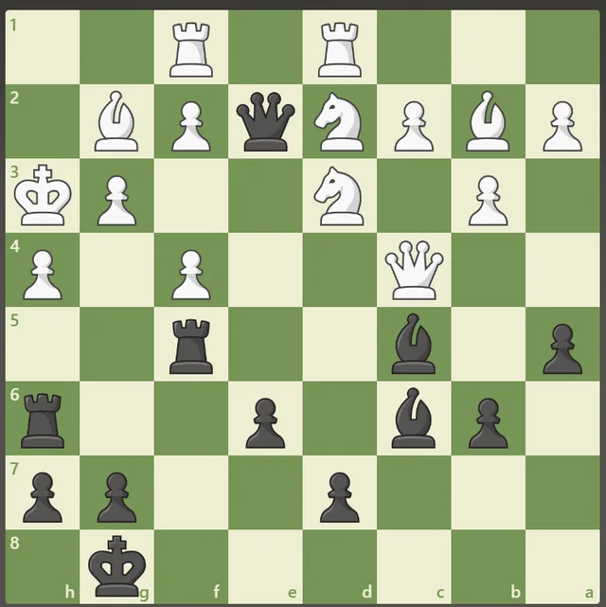
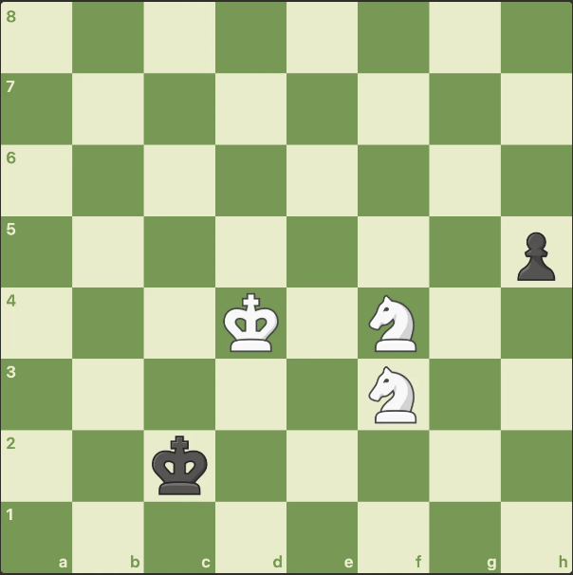
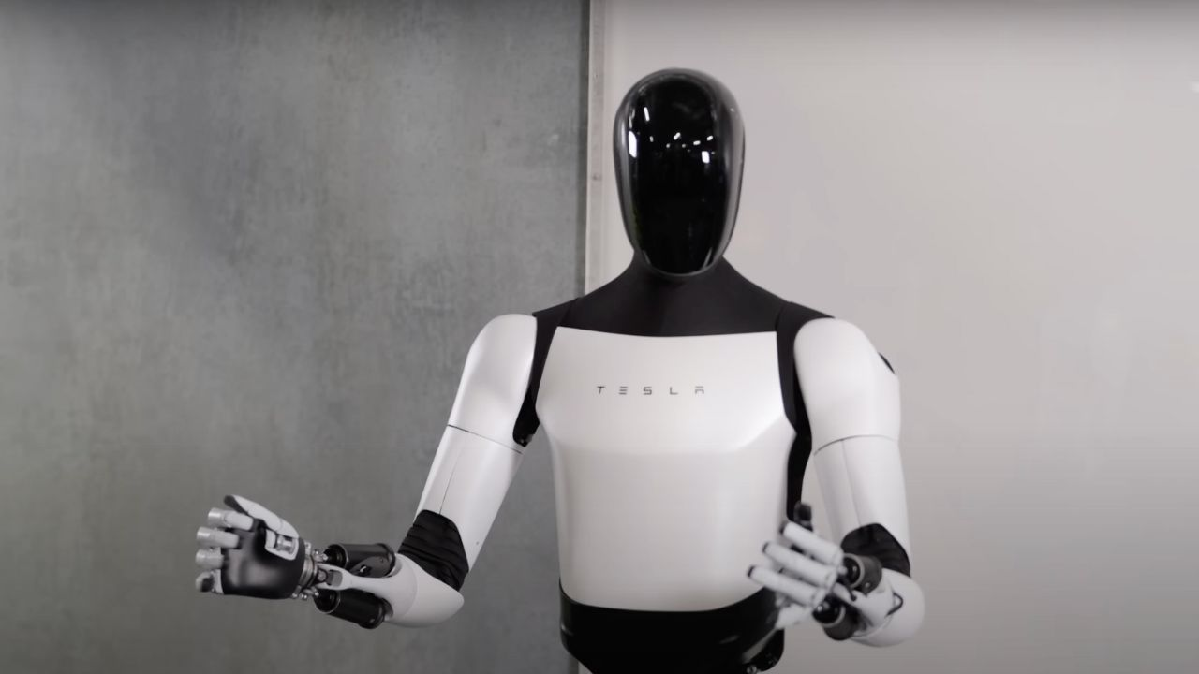
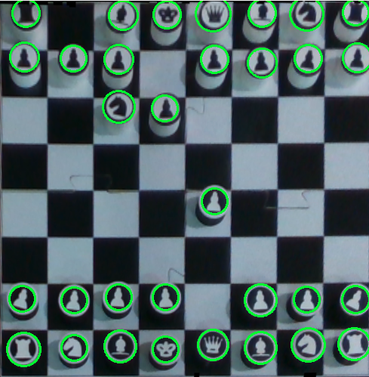
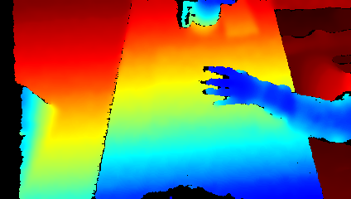
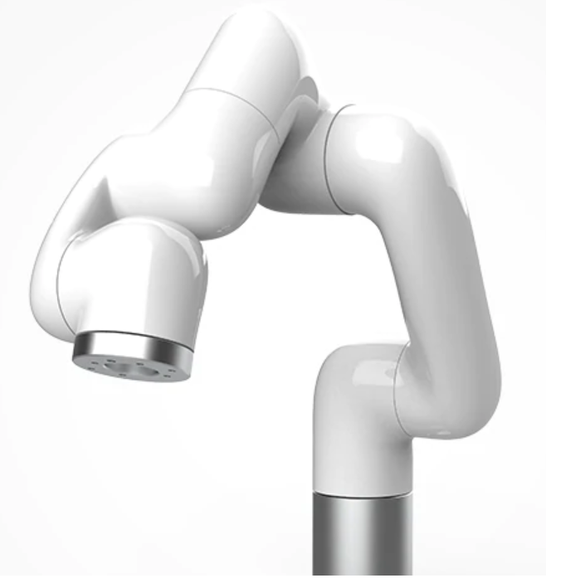
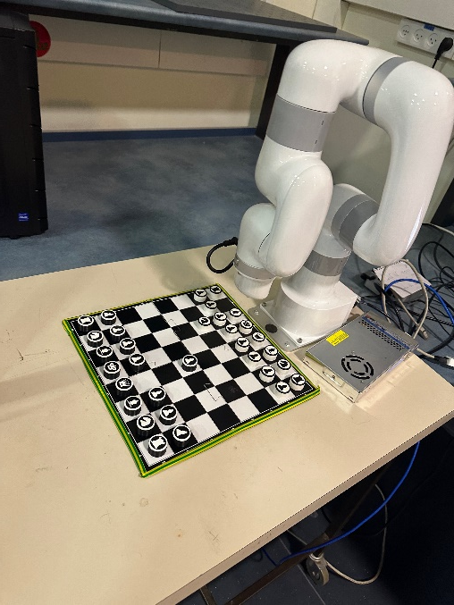
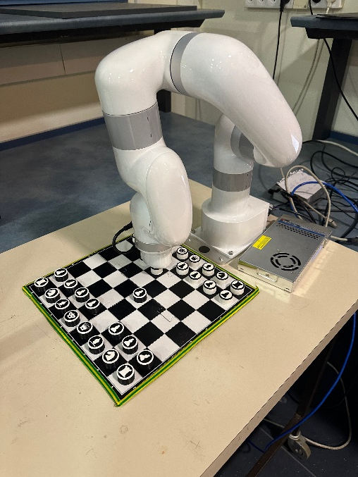
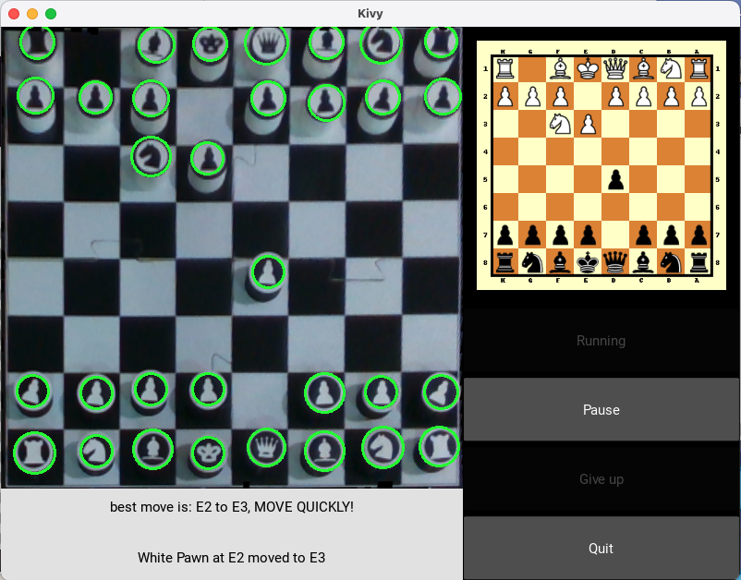
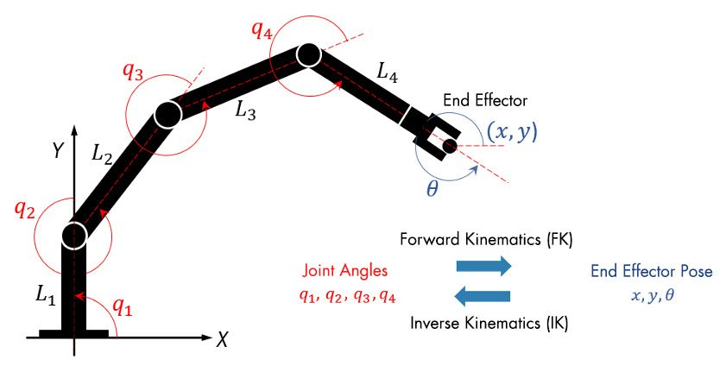
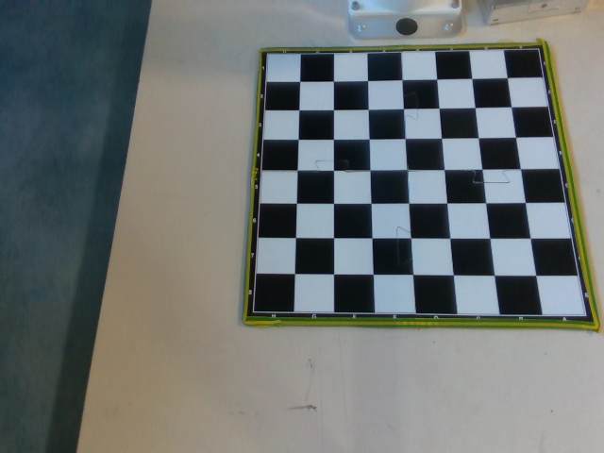
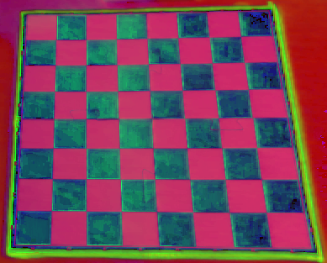
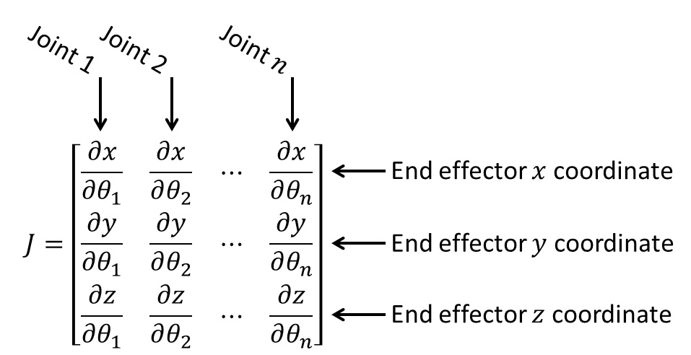
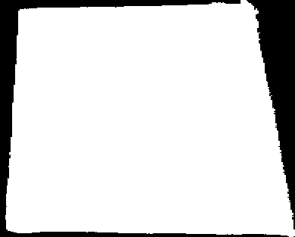
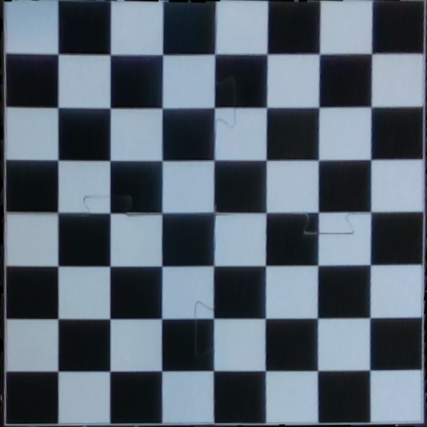
RoboChess: Chess Playing Robotic Arm
Using Image Processing & Computer Vision
Ahmad Ghanayem and Muhammed Ghanayem, Supervised by Elisei Shafer
Introduction
Move Recognition Algorithm
Stockfish Engine
Recent technologies e.g., AI pushed robotics field more into the spotlight.
With chess becoming more popular lately, our project aims to elevate the experience through innovative technology.
Integrating the rising popularity of chess with advancements in robotics, our project pioneers an interactive robotic chess experience.
Circle Hough transform based solution.
Beginning with the chess starting position, we track every move for interactive gameplay.
Accurate and consistent piece detection.
Stockfish is a chess engine designed to analyze and improve players' chess strategies.
Used to identify the optimal next move in a game.
checks the legality of moves made by players.
Input Frame
Detect Chessboard Corners
chess.com puzzles made by stockfish engine
Motion Detection
Tesla Optimus Gen 2 AI Humanoid
Circle Hough on each square
We capture and store the initial depth map at the game's start.
If the current depth map differs from the initial, we pause the game.
Players can move pieces by hand, temporarily halting scans until their hand is removed.
A circle's shift from one square to another indicates movement.
If a circle disappears, it signals a capture, pixel comparison reveals the captured piece.
Goals
Building a fully functioning chess game against robotic arm based on,
Stereo depth camera.
Physical chess board and pieces.
Gameplay guided by visual cues, no computer interaction needed.
Arm Control
Challenges
Depth map from from Intel Realsense D435
Identifying player actions.
Detect the chess board in the frame.
Picking and Placing chess pieces with the robot.
Solving incorrect moves.
Pinpointing piece locations for precise robotic arm movement.
Results
A fully operational chess game with a robotic arm, including complex moves like castling and en passant.
A user interface accompanies the game for display and control purposes.
The ability to detect illegal moves.
xArm Lite 6 with no end effector
The arm receives starting and ending squares, then guides its movements precisely.
Using inverse kinematics, we calculate precise joint angles based on desired distances.
If gripping fails, the arm continues searching with varying search radii until success.
When the gripper detects a pressure change, it confirms a successful vacuum grip.
Chessboard Detection
Input Frame
HSV Color Space
Find ROI
Robotics kinematics model
A sequence of moves is executed
by the arm
UI visualizes chess game progress.
ROI
Warped Frame
Conclusions
Warp Frame
Accurate chessboard detection in space and division into 8x8 squares.
Successful game-state detection after each change in the physical chessboard.
Successful and accurate pick and place by the robot even upon initial failures.
Interactive game with varying difficulty levels.
The ROI (region of interest) contains the chessboard in the frame.
We store the masks for future use.
For each frame after the initial detection we apply the already stored masks to get the same ROI.
Inverse kinematics Jacobian matrix
March 2024

